Slide 1
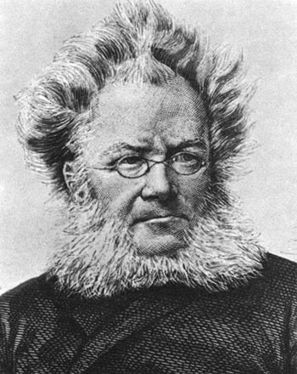
Step Out
Context
Ibsen’s Modern Theatre late 1800s

Slide 2
Context—key definitions
Context of production
  The environment in which a text is produced. This includes the social, historical and cultural conditions.
Context of the text
  When the text is set/occurs, which can be a different time than when the text was written
  Context of the reader
  The environment/time a text is read.
  Parts of your personal context are your understandings, values, beliefs, experiences, past reading of texts that you bring to a text.
Context is tied to and promotes specific ways of thinking along with specific values, attitudes and beliefs

Slide 3
Understandings of Context
What changes in society were occurring in the late 19th and early 20th centuries?
What caused these changes and/or inspired the call for change?
How does the play draw upon and/or question the social or historical context of its time through the actions/dialogue/conflicts of the text?
How does A Doll’s House challenge the way people/audiences think?
What differences can we note between the context of a modern readership (i.e. us), and that of the original audience? How might different audiences respond?

Slide 4
Societal and Cultural Changes
In the latter part of nineteenth century (Doll’s House published 1879), debates were occurring in society on many burning questions:
  Relationships in marriage
  The relationship between the sexes
  The conditions of the workers (Unions)
  Confrontation with religion
  Awareness of class as permeable and valuing upward mobility
We need to know WHY was this a time for big questions and changes.

Slide 5
Context of Production
Post-Industrial Revolution: Growth of urban living as people leave country for work. Cities swell with crime, poverty, squalor. 1760 to sometime between 1820 and 1840. By 1879, when Ibsen is writing, the effects of the revolution are leading to more changes and questions.
Social and Cultural Changes
Development of modern industrial societies and the rapid growth of cities
Science boom: rationality and logic versus traditional religious beliefs
Big challenges to traditions in art, architecture, literature, religious faith, social organization and daily life
There were new economic, social, and political conditions of an emerging fully industrialised world.
  there was more wealth for a certain few
  This new wealth created room for an additional economic class
With all these changes to society, there were shifts in power and/or calls for changes to who has power

Slide 6
Social Context
Gender Roles—note the implied value, attitudes and/or beliefs
  Agitation for women’s rights had been mounting steadily over Europe and America since 1789-99
  Napoleonic Code (1804) still in force/accepted– declared all men equal but left women subject to the will of fathers and husbands.
  Married women in England could not inherit property
  Women had no vote
  It was difficult for a woman to obtain a divorce and she would generally lose custody of her children.
  First-wave Feminism

Slide 7
Social Context
Class--Emergence of Bourgeois—note the implied values, attitudes and/or beliefs
  Bourgeois means belonging to or characteristic of the middle class, typically with reference to its perceived materialistic values or conventional attitudes.
  In the Western world, between the late 18th century and the present, the bourgeoisie are a social class "characterized by their ownership of capital,* and their related culture".
    *Capital is distinct from land in that capital must itself be produced by human labor before it can be a factor of production.

Slide 8
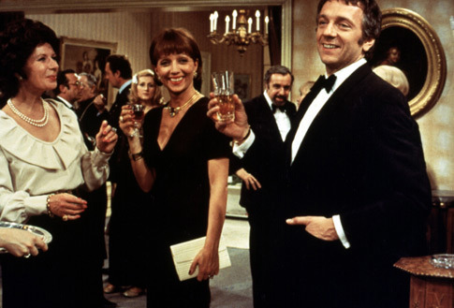
Bourgeois – adjective (having qualities associated with middle class; beliefs, values, attitudes, lifestyle etc.).
Bourgeoisie – noun

Slide 9
A New Class Hierarchy
Royalty—inherited land and inherited wealth
Nobility—inherited land and inherited wealth
Wealthy--earned wealth, limited land
Upper Middle Class—earned wealth, limited land
Middle Class
Working Class
Lower Class

Slide 10
Real World Context
Based on the life of Laura Kieler - a good friend of Ibsen.
Much that happened between Nora and Torvald happened to Laura and her husband, Victor.
  Laura signed an illegal loan to save her husband. She wanted the money to find a cure for her husband's tuberculosis.[
  She wrote to Ibsen, asking for his recommendation of her work to his publisher, thinking that the sales of her book would repay her debt.
  At his refusal, she forged a check for the money.
  She was found out. When Victor discovered about Laura's secret loan, he divorced her and had her committed to an asylum.
  Two years later, she returned to her husband and children at his urging, and she went on to become a well-known Danish author, living to the age of 83.
Ibsen wrote A Doll's House when Laura Kieler had been committed to the asylum – guilt? He turned this life situation into an aesthetically shaped, successful drama. In the play, Nora leaves Torvald with head held high, though facing an uncertain future given the limitations single women faced in the society of the time.
Kieler eventually rebounded from the shame of the scandal and had her own successful writing career while remaining discontented with sole recognition as "Ibsen's Nora" years afterwards

Slide 11
Ibsen’s comment on values attutudes / context
He outlined his conception of the play as a "modern tragedy" in a note written in Rome on 19 October 1878.
"A woman cannot be herself in modern society," he argues, since it is "an exclusively male society, with laws made by men and with prosecutors and judges who assess feminine conduct from a masculine standpoint."

Slide 12

I feel or I am positioned by the text to feel: supportive, critical , positive, doubtful, suspicious, comfortable, fearful, welcoming, confident, passionate, apathetic, offended, etc.
An outlook or perspective or a specific feeling about something. Attitudes can be expressed by what we say, do and wear.
Held by me and/or a society, promoted by texts and can be based on a value: marriage is between man and woman, freedom of expression is important, empathy matters, hard work pays off, people deserve similar opportunities, etc.
Something held to be a truth without the support of evidence. A conviction, understanding, view, opinion or acceptance that certain things are true or real.
I or texts see/show this as important for a functioning society: family, freedom, community, responsibility, equality, nature, success, etc.
Concepts or notions that a person and/or social group hold to be correct or of some worth.

Slide 13
Back to the big questions and understandings you need:
What changes in society were occurring in the late 19th and early 20th centuries?
What caused these changes and/or inspired the call for change?
How does the play draw upon and/or question the social or historical context of its time through the actions/dialogue/conflicts of the text?

Slide 14
Big Questions to Consider
How does A Doll’s House challenge the way people/audiences think?

Slide 15
A final Big Question
What differences can we note between a the context of a modern readership (i.e. us), and that of the original audience?
  How might different audiences respond to this text and why?

Slide 16
Drama had a new purpose thanks to Ibsen.
Context created genre?
Developed the genre of Realist theatre--the portrayal of ‘real’ people and ‘real’ situations
  Many people felt that the prevalent theatrical style had become mannered and false (see Well-made Play)
  Ibsen was ground-breaking in his invention of Realism to take on social and political issues
  Realism presented social critique
  This shocked audiences in 1879

